Slide 1

An interesting architecture based on competitive learning process by
Finish Professor Teuvo Kohonen [ Helsinki University of Technology, Laboratory of Computer and Information Science, Neural Network Research centre, Finland ] introduced in 1990
called
SELF-ORGANIZING MAPS
Kohonen’s SOM is a widely-used ANN model based on the idea of
self-organized or unsupervised learning

Slide 2

About this book: The Self-Organizing Map (SOM) - one of the most realistic models of the biological brain function in the unsupervised learning category.
Many fields of science have adopted SOM as a standard analytical tool in : statistics, signal processing, control theory, financial analysis, experimental physics, chemistry and medicine.

Slide 3
Clustering:
There are a number of different NN architectures specifically designed for clustering. The most widely known is probably self organizing maps.
A SOM is a NN that has a set of neurons connected to form a topological grid (usually rectangular).
When some pattern is presented to an SOM, the neuron with closest weight vector is considered a winner and its weights are adapted to the pattern, as well as the weights of its neighbourhood.
In this way an SOM naturally finds data clusters

Slide 4
A new application area of SOM is :
organization of very large document collections.
Given a set of text documents, NN can learn a mapping from document to real-valued vector in such a way that resulting vectors are similar for documents with similar content

Slide 5
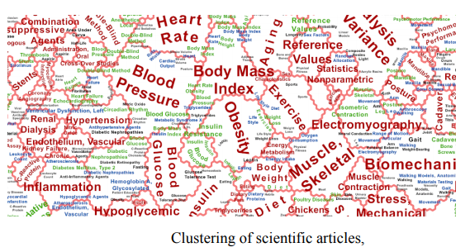
Massive document collections can be organized using a SOM. It can be optimized to map large document collections while preserving much of the classification accuracy

Slide 6
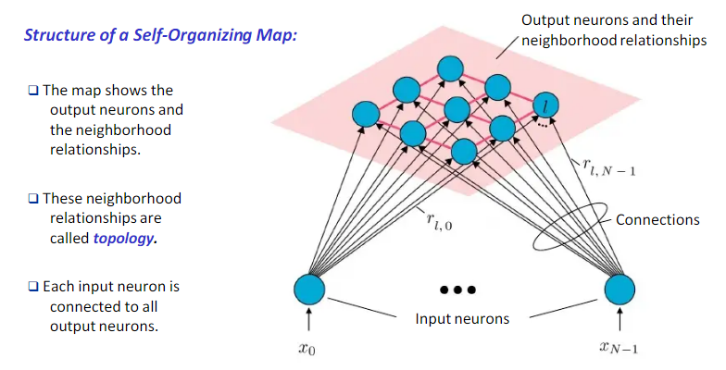

Slide 7
SOM / KOHONEN MAPS combines
competitive learning with
topology preserving mapping i.e.
Nearby input patterns should activate Nearby output units on the map

Slide 8
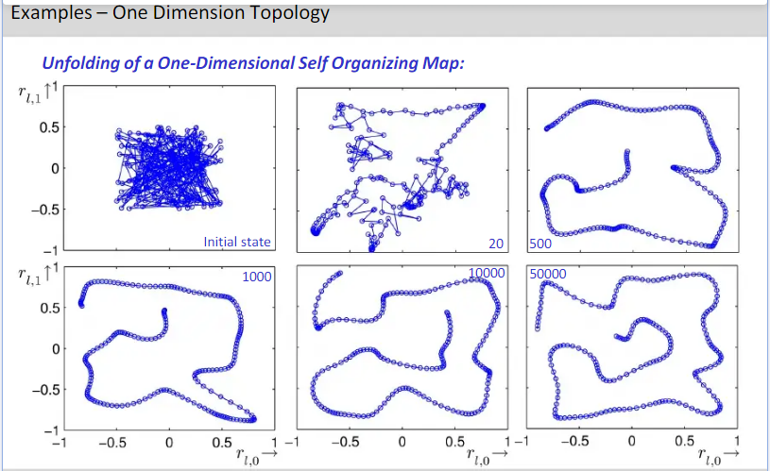

Slide 9
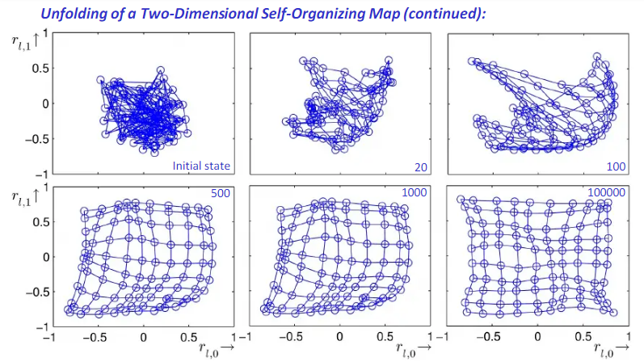

Slide 10
Initial random weights
100 output nodes,
2D inputs.
Weight to 100 output nodes from two input nodes as a feature map
The horizontal axis represents the value of the weight from input x₁ and vertical axis represents the value of weight from input x₂ .
W(2,j)
W(1,j)

Slide 11
Network after 100 iterations
W(2,j)
W(1,j)

Slide 12
Network after 1000 iterations
W(2,j)
W(1,j)

Slide 13
Network after 10,000 iterations
Lines connect weights for nodes that are nearest neighbors.
An orderly grid indicates that topologically close nodes code inputs that are physically similar.
W(2,j)
W(1,j)

Slide 14
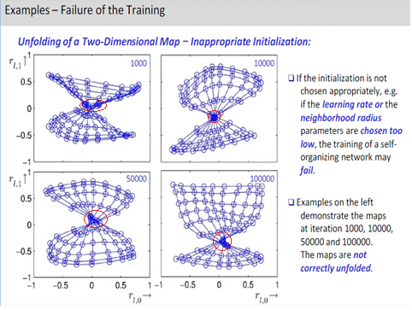
Red encicled -undesirable

Slide 15
Competitive learning
In competitive learning, neurons compete among themselves to be activated.
The output neuron that wins the “competition” is called the winner-takes-all neuron or simply the winning neuron.
Competitive learning rule is a form of unsupervised training where output units are said to be in competition for input patterns.

Slide 16
During training, the output unit that provides the highest activation to a given input pattern is declared the winner and weights of winner node is moved closer to the input pattern, whereas the rest of the neurons are left unchanged.
In Hebbian learning, several output neurons can be activated simultaneously, and weights of all are changed, in competitive learning, only a single output neuron is active at any time.

Slide 17
In a competitive neural network, the neurons ‘compete’ to be activated.
Activation is a function of distance from a selected data point.
The neuron closest to the data point — that is, with the highest activation — ‘wins’, and is moved towards the data point, attracting some of its neighbourhood.
competitiveness allows learning topology

Slide 19
Types of Self-Organizing Networks
Learning Vector Quantization (LVQ)
Kohonen Maps
Principal Components Networks (PCN)
Adaptive Resonance Theory (ART)

Slide 20
KOHENON MAPS :
The basic units are neurons
organized into two layers: the input layer(input nodes) and the output layer ( output map), output nodes are called computational nodes
All the input neurons are connected to all the output neurons, and these connections have strengths/weights, associated with them.
The output map is a 1-D(string) /2-D grid/mesh of neurons, with no connections between the units.

Slide 21
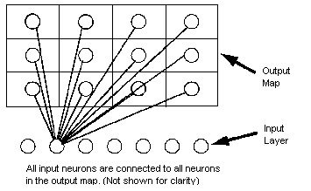
One dimensional map will just have a single row (or a single column) in the computational layer.

Slide 22
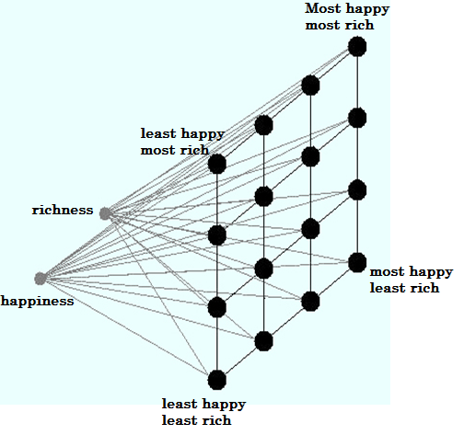
The advantage of SOM is that it allows one to easily tell how a country is ranked among the world with a simple glance of the learned
Units

Slide 23
Feature-mapping Kohonen model
it is a very useful technique for clustering analysis, and exploring data.

Slide 24
Kohonen Maps

Slide 25
Kohonen Maps
The input x is given to
all the units at the same
time

Slide 26
Kohonen Maps
The weights
of the winner unit
are updated
together with the weights of
its neighborhoods

Slide 27
What really happens in SOM ?
Each data point in the data set recognizes themselves by competing for representation.
SOM starts from initializing the weight vectors.
A sample vector is selected randomly and the map of weight vectors is searched to find which weight best represents that sample.
Each weight vector has neighboring weights that are close to it.

Slide 28
The weight that is chosen is rewarded by making it more like that randomly selected sample vector.
The neighbors of that weight are also rewarded by being able to become more like the chosen sample vector.
This allows the map to grow and form different shapes.
Most generally, they form square/rectangular/hexagonal/L shapes in 2D feature space.

Slide 29
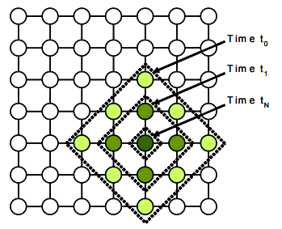
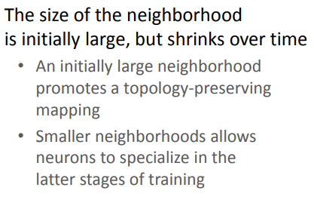

Slide 30
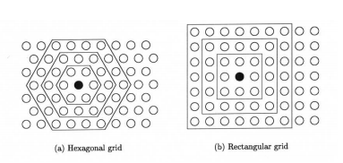
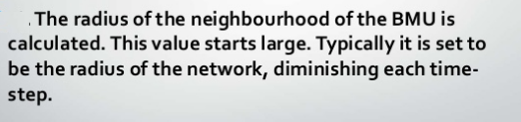

Slide 31
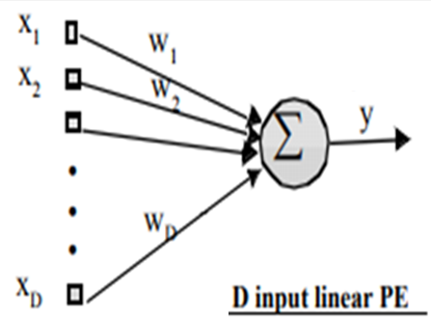

Geometric Interpretation of INNER PRODUCT
D dimensional INPUT
LINEAR Processing Element(PE)
Scalar output
Inner product is multiplying 2 vectors, computed as product of the length of vectors times the cosine of angle between them to produce scalar y

Slide 32

A small y means that the input is almost perpendicular to w (cosine of 90 degrees is 0), i.e. x and w are far apart.
Magnitude of y measures similarity between the input x and the weight w using the inner product as the similarity measure.
Inner product tells you about how much of the vectors are in the same direction, as opposed to
the cross product which tells you the opposite, how little the vectors are in the same direction (called orthogonal).

Slide 33
Instead of finding nearness by calculating inner product y = wx
distance between weight and input is calculated, and weight vector is rotated towards the input, means
weight is moved closer to INPUT
Weights of the winner node are updated

Slide 34
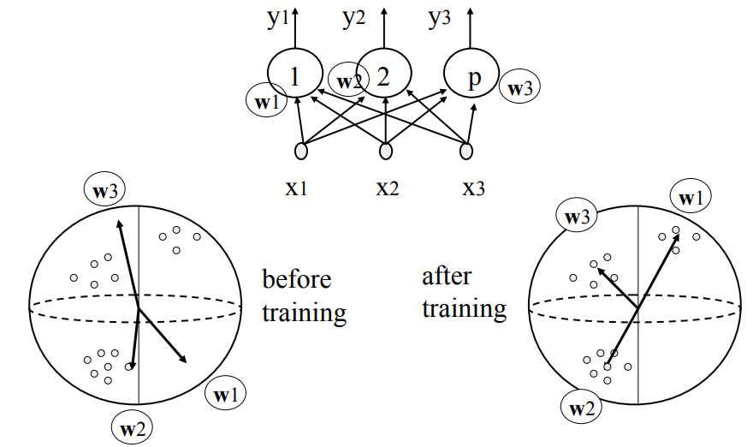

Slide 35
The overall effect of the competitive learning rule is:
MOVE the synaptic weight vector W_{j} of the winning neuron j towards the input pattern X.
The aim is to arrive at minimum Euclidean distance between vectors.

Slide 36
Training steps
Each node's weights are initialized.
A vector is chosen at random from the set of training data and presented to the lattice.
Every node is examined to calculate which one's weights are most like the input vector. The winning node is known as the Best Matching Unit (BMU).

Slide 37
5. The radius of the neighbourhood of the BMU is now calculated. This is a value that starts large, typically set to the 'radius' of the lattice, but diminishes each time-step. Any nodes found within this radius are supposed to be inside the BMU's neighbourhood Weights of BMU and neighbouring nodes of the winner node are adjusted to make them more like the input vector.
6. The closer a node is to the BMU, the more its weights get altered.
7. Repeat step 2 onwards for N iterations.

Slide 38

DISTANCE(DISIMILARITY ) MEASURE
A distance function provides distance between the elements of a set.
MINKOWSKI DISTANCE
The Minkowski distance between two n-dimensional variables X and Y is defined as :
p = 1 is equivalent to the Manhattan distance [ City block] Because of gridlike street geography of New York borough (area) of Manhattan.
p = 2 is equivalent to the Euclidean distance.
.

Slide 39
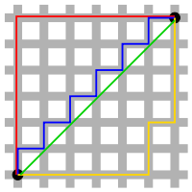
the red, yellow, and blue paths all have the same shortest path length of 6+6=12.
In Euclidean geometry, the green line has
6x(2)^{0.5} length and is the unique shortest path.

Slide 40
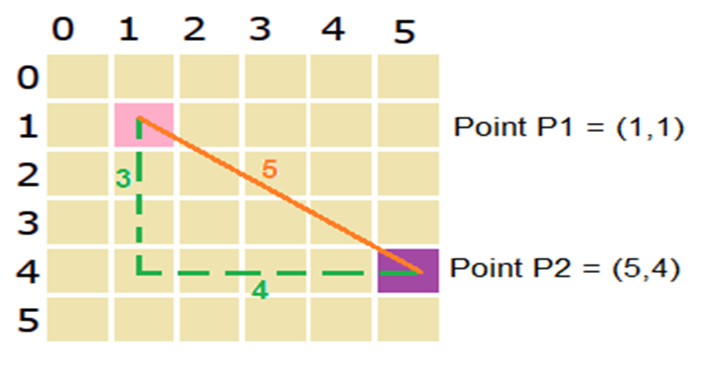
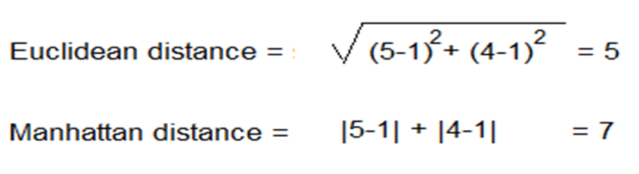
DISTNCE MEASURE

Slide 41
The competitive learning rule defines the change Δw_{ij} applied to synaptic weight w_{ij} as
where x_{i} is the input signal and α is the learning rate parameter.
IMP:
W is moved towards X so X-W,
Remember it is not absolute difference

Slide 42
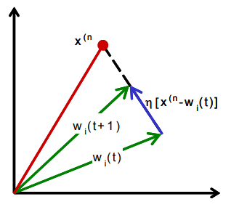

Slide 43
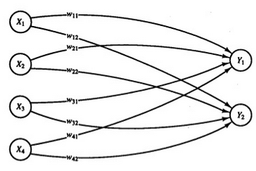
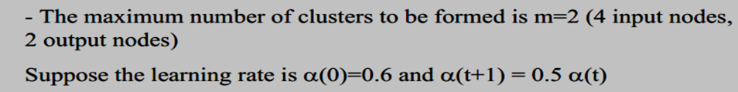

Slide 44
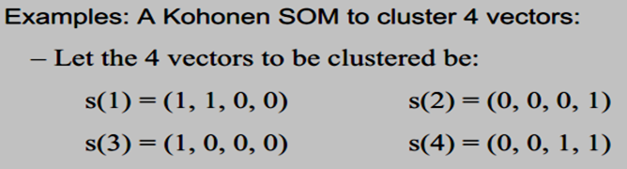

Slide 45
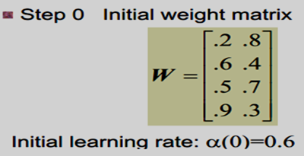

Slide 47
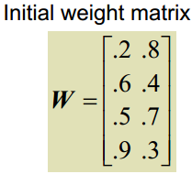
P1 (1,1,0,0) ; P2(0,0,0,1)
P3 (1,0,0,0) ; P4(0,0,1,1)
Step 4: Input vector(1) is closer to o/p node 2, so
j=2 is winner node and weights associated with node 2 are updated

Slide 48
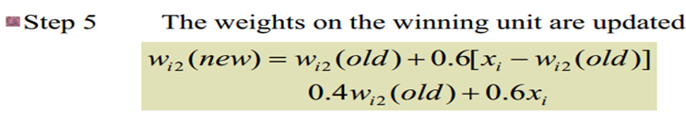
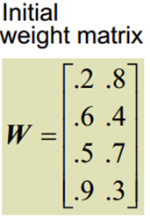
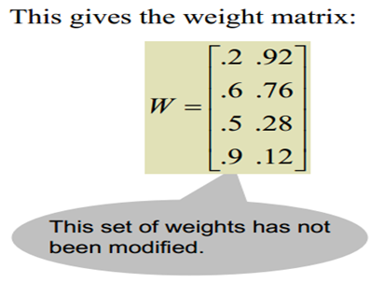
Calculate new weights [P1=1,1,0,0]
Input was 1100
w₁₂ (.8 to .92) and w₂₂ (.4 to .76) have increased, so distance will decrease from 11
w₃₂ (.7 to .28) and w₄₂ (.3 to .12) decreased so distance will decrease from 00

Slide 49
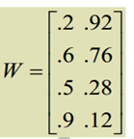


Slide 50

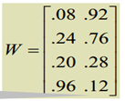
Calculate new weights
Input 0 0 0 1, w₁₁ and w₂₁ and w₃₁ have decreased
w₄₁ increased

Slide 51


Slide 52


Only W₁₂ increased and all others decreased Input 1 0 0 0

Slide 53
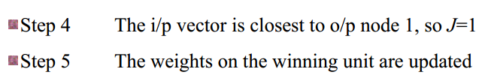

Slide 54
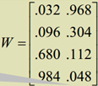
w₁₁ and w₂₁ decreased
w₄₁ and w₃₁ increased,

Slide 55
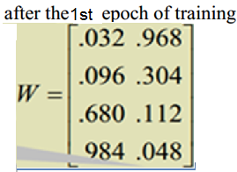
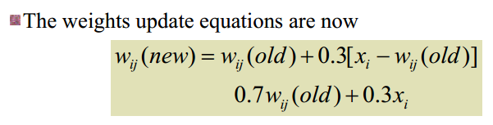
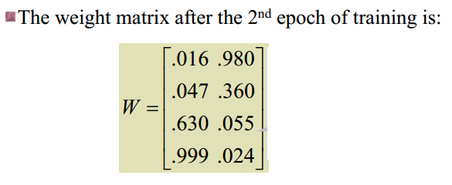
P1= (1,1,0,0) ; P2=(0,0,0,1)
P3= (1,0,0,0) ; P4=(0,0,1,1)

Slide 56
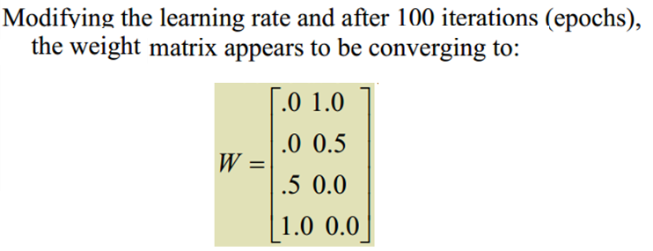

Slide 57
After 100 iteration
After 100 iterations, distance from node 2 has decreased from 0.98 to 0.25, and distance from node 1 has increased from 1.86 to 3.25, P1=1100 belongs to cluster 2

Slide 58
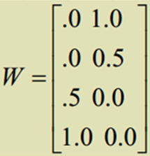
Appear to be converging towards:

Slide 59
P1 =(1,1,0,0)
weights do not change ,P1[1100] is in cluster 2

Slide 60
Winner is Node 1,weights do not change( α too small), input 2 is in cluster 1

Slide 61
Winner is Node 2,weights do not change, input 3 is in cluster 2

Slide 62
Winner is Node 1,weights do not change, input 4 is in cluster 1

Slide 63
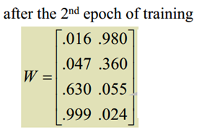

Avg of vectors in c1 : 0,0,0.5,1
Avg of vectors in c2 : 1,0.5,0,0
Each weight vector moves to the average position of all of the input vectors for which it is a winner

Slide 64
Stable under the introduction of new knowledge (data), and not forget the old.
Plastic under the addition of new knowledge - Able to add new data to its function.
“A system that must be able to learn to adapt to a changing environment (i.e it must be plastic) but the constant change can make the system unstable, because the system may learn new information only by forgetting everything it has so far learned".

Slide 65
One way to achieve stability is to force the learning rate to decrease gradually as the learning process proceeds, and so it eventually approaches zero.
However, this artificial freezing of learning causes another problem termed PLASTICITY, which is defined as the ability to adopt to new data.
This is known as Grossberg’s Stability-Plasticity dilemma in competitive learning

Slide 66
END

